Slide 1

User Behavior Analysis

Slide 2
Executive Summary
Demographics: Majority of users are aged 45–65, with balanced gender distribution.
Financial Risk: Over 668 users have debt-to-income ratio >100% — extreme financial stress.
Spending Behavior: Regular debit cards dominate transaction volume.
Popular Merchants: MCC 5411 (Grocery) and 5499 (Convenience Stores) are most used.
Transaction Method: Swipe is the dominant payment method — higher fraud risk.

Slide 3
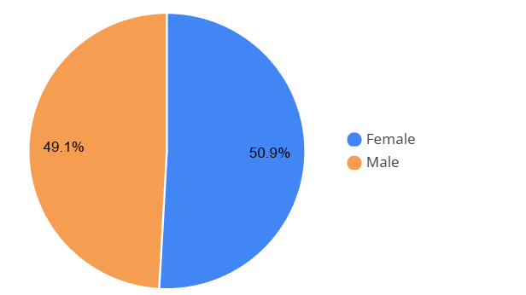
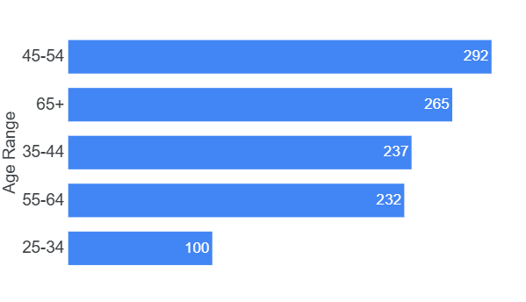
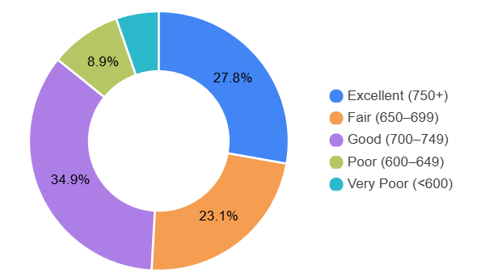
User Demographics
Gender Distribution
Age Distribution
Credit Score Categories
➤ Nearly equal split — marketing should be gender-neutral.
➤ Core user base is middle-aged to senior — focus on stability and trust.
➤ Most users have fair to good credit — eligible for credit products with caution.

Slide 4
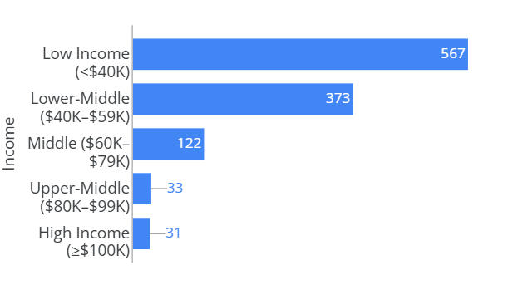
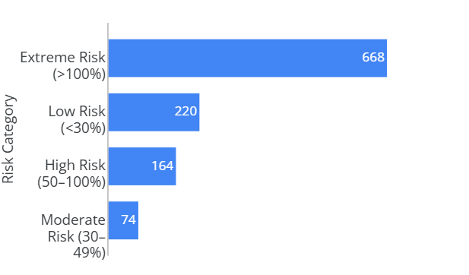
Financial Health & Risk Profile
Income Distribution
Debt-to-Income Risk Categories
➤ Majority are low to middle-income — affordability is key.
➤ Over half a million users spend more than they earn — urgent financial wellness programs needed.

Slide 5
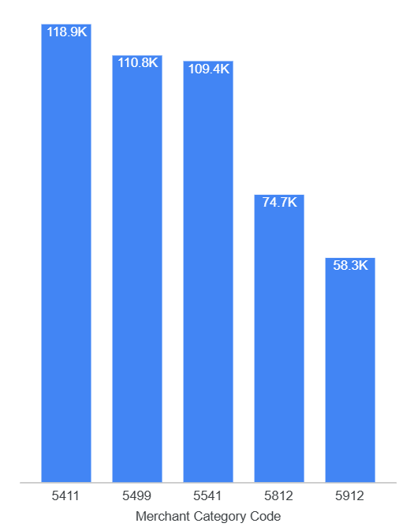
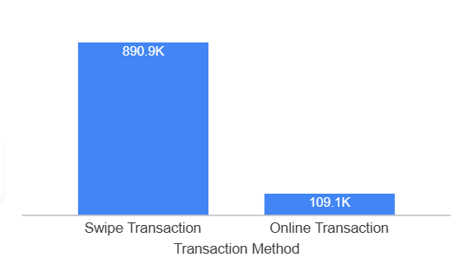
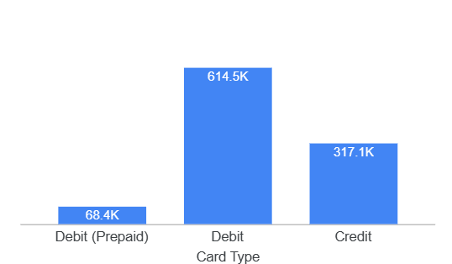
Transaction Behavior
Top 5 MCC
Transaction Method
Card Type Usage
➤ Swipe is the dominant method — but higher fraud risk. Push for chip/online adoption.
➤ Regular debit cards dominate — users prefer direct access to bank funds.
➤ Focus loyalty programs on daily essentials.

Slide 6
Key Insights & Patterns
Insight | Implication
Older users dominate | Tailor UX for simplicity and trust.
High DTI risk | Launch financial wellness tools or debt counseling.
Regular debit cards = most used | Expand regular debit benefits.
Swipe = primary method | Educate users on chip/contactless safety.
Grocery & convenience stores = top spend | Partner with convenience stores for cashback.

Slide 7

Thank You

